Slide 1
Week 1a : Introduction

Slide 2
I’m very happy you’re here
I really like 3d graphics
We got a lot of class hours
It’s a very satisfying topic due to instant feedback

Slide 3
This class
Contents of this course
Evaluation of this course
Some bureaucracy
Get our hands dirty with Unity

Slide 4
Contents of this course
What are you all hoping to learn in this course?

Slide 5
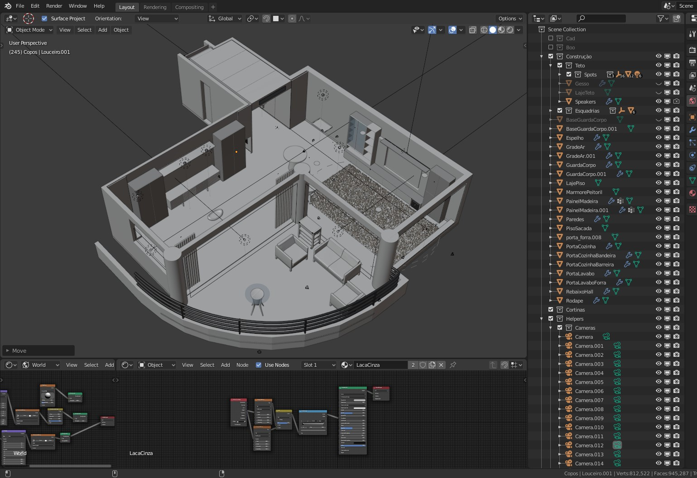
What are “3D graphics”?
“Images representing a 3d scene created by transforming 3d models and textures using algorithms”
This is not *the* definition, this is my definition
It’s a badly defined term

Slide 6
Creating 3D graphics
We need to create 3D models : 3D modeling
We need to create textures : Texturing
We need to create a scene : World Building
We need to transform them : ??? Does anyone know the term ???

Slide 7
This course should be called 3D rendering
Rendering : creating an image, based on a description of a scene, using algorithms
Description is models, textures, animations, camera settings… and a bunch of other stuff
“graphics programming” would also be a good name for this course

Slide 8

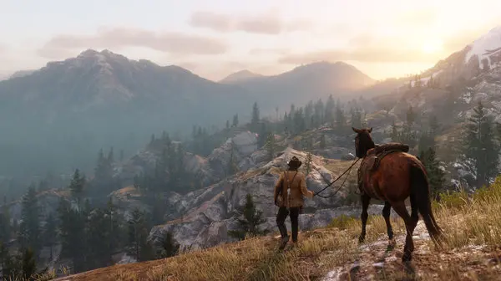
There are two kinds of rendering
Does anyone know the difference?

Slide 9
There are two kinds of rendering
Movie
Game

Slide 10
There are two kinds of rendering
Game Do calculations continuously
Why?
Offline rendering Do calculations once

Slide 11
There are two kinds of rendering
(offline) rendering
Realtime rendering

Slide 12
What is the big difference?
How long do we have to render the frame? Assume we’re rendering 60 frames per second (fps)

Slide 13
What is the big difference?
60 frames per second
1 second / 60
16.6 ms per frame

Slide 14
What is the big difference?
How long do we have to render the frame?
Movies display at least 24 fps

Slide 15
What is the big difference?
How long do we have to render the frame?
Movies display at at least 24 fps

Slide 16
Trick question! It doesn’t matter
We only need to render once (no user input)
Anecdotally, about 80-400 hours on a single pc for one frame, but is always rendered on a farm

Slide 17
This course should be called “realtime 3D rendering”
We need to learn how to make 3D images
We need to use the graphics card (GPU) to do it fast enough

Slide 18

Course schedule
 | Monday | Thursday
Week 1 : 12/02 | Introduction | C#/Unity Lab
Week 2 : 19/02 | 3D reasoning | 3D Lab
Week 3 : 26/02 | Basic Pipeline | Lab
Week 4 : 04/03 | Textures Normal maps | Post processing / lab
Week 5 : 11/03 | Camera’s Light | lab
Week 6 : 18/03 | Advanced pipeline | Advanced pipeline lab
Week 7 : 25/03 | Materials Aliasing | Materials Lab
Week 8 : 15/04 | Procedural generation | Procedural generation lab
Week 9 : 22/04 | Project explanation | Project lab
Week 10 : 29/04 | Guest Lecture Project Labs | Guest Lecture Project Labs
Week 11 : | Revision | Revision
Highly likely to change ☹

Slide 19
This might not make a lot of sense yet
We’ll do some hands one things with Unity this class and (hopefully) it will start to make more sense
Unfortunately, this will be true of this course as well. Rendering is a lot of simple separate parts, that only make once you can make the connections

Slide 20
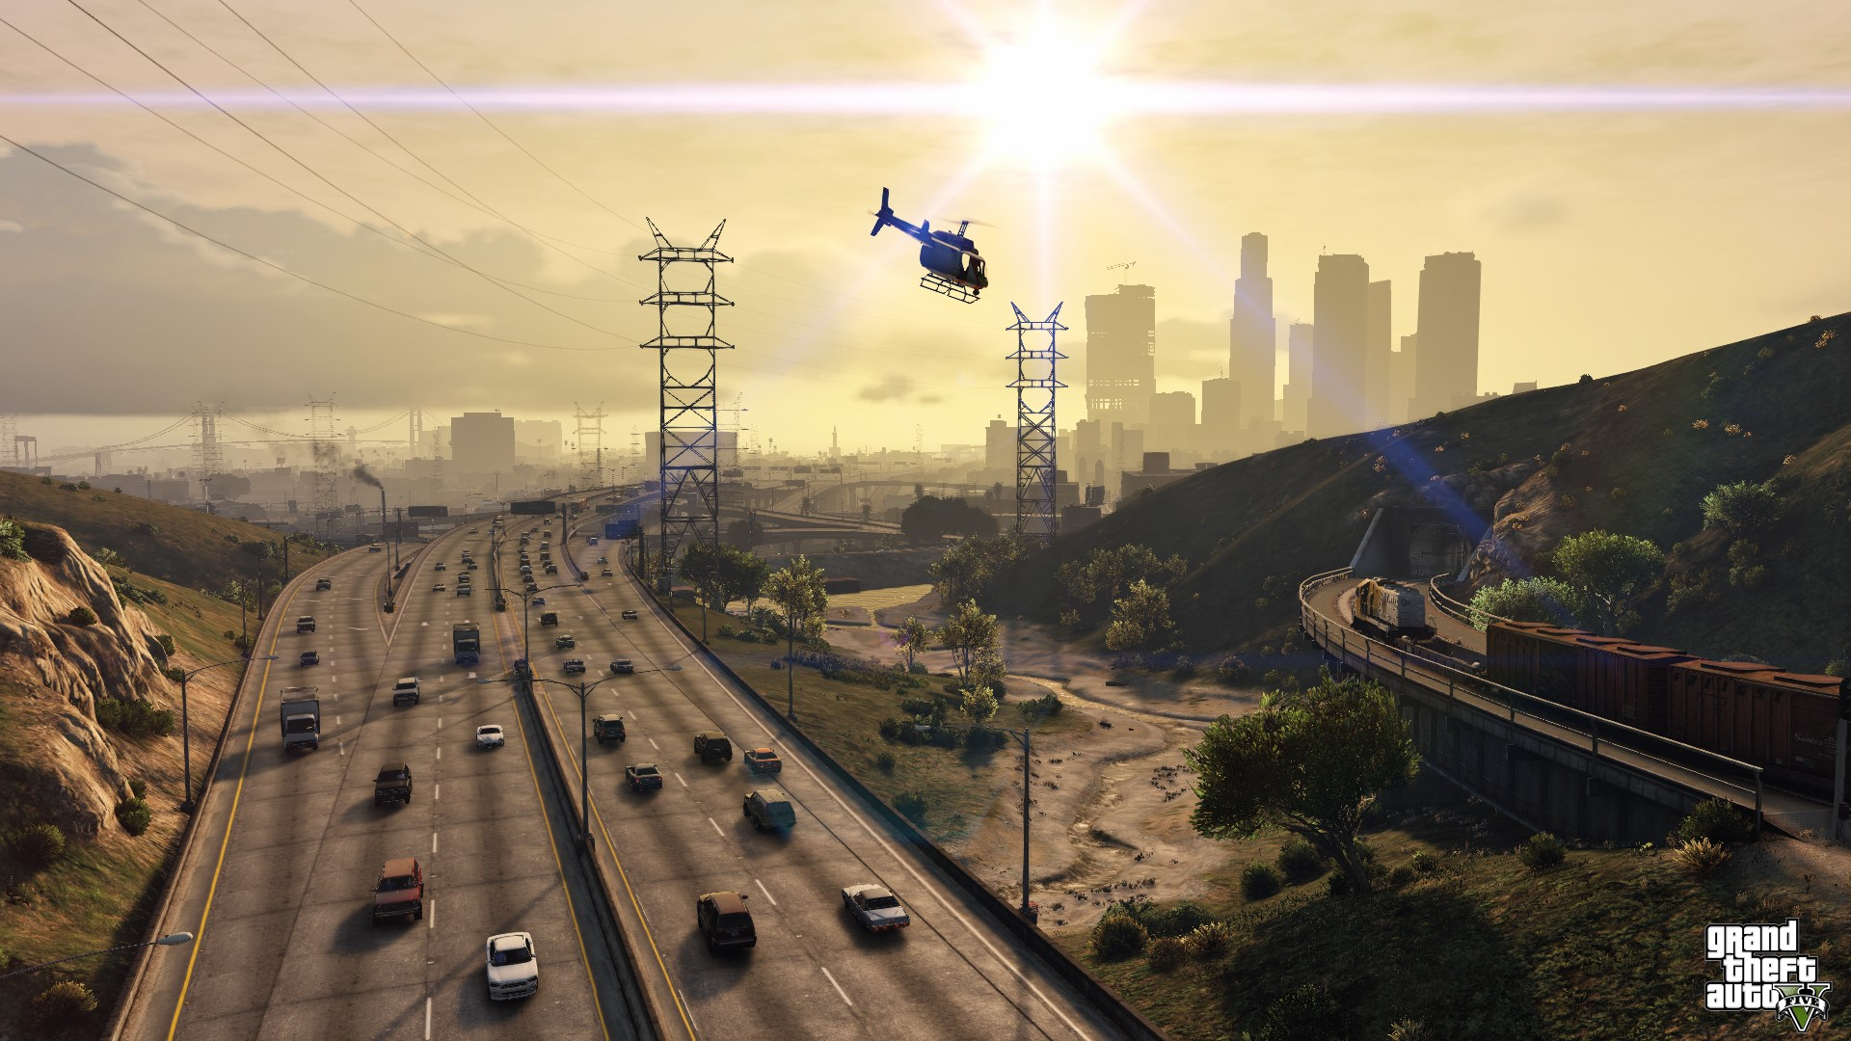
Reframe: we want to understand why a pixel has it’s color

Slide 21
What questions do you have?

Slide 22
This class
Contents of this course
→ Evaluation of this course ←
Some bureaucracy
Get our hands dirty with Unity

Slide 23
Evaluation of this course
8 points on lab exercises
12 points on project
Oral exam defending both
Deadlines will be posted this week
Danger : oral exam checks you understand what you did in the exercises and project. It’s a defence, but it’s also an oral exam of the theory as you used it.

Slide 24
Lab exercises
Multiple short exercises per topic
Should cover as much of the course as is possible
Where an exercise is impossible, I will provide a quiz to check your progress

Slide 25
Project
Figuring out scope
Not a group project
Going to implement one or two predetermined features

Slide 26
Is that clear? Any concerns?

Slide 27
This class
Contents of this course
Evaluation of this course
→ Some bureaucracy ←
Get our hands dirty with Unity

Slide 28
Questions
Just put up your hand
If it’s not related to lesson, ask at the start of end so other people hear

Slide 29

Contacting me : send me an email!
I usually respond in 3 or 4 working
I might miss you on Toledo or Teams, just send me an email
I never get enough emails from my students
Write me in English or Dutch

Slide 30

Abscences
Class is not mandatory \o/
I strongly recommend you come
This is a hard subject to condense into 2 weeks
Bugs can be hard to track down

Slide 31
ChatGPT et al
Of course you’re allowed to use ChatGPT to do your labs / project
ChatGPT and other LLM’s are not allowed during the exam
Use it to understand, not to make
I’ve used ChatGPT and it creates Unity code that…. I disagree with

Slide 32
This class
Contents of this course
Evaluation of this course
Some bureaucracy
→ Get our hands dirty with Unity ←

Slide 33
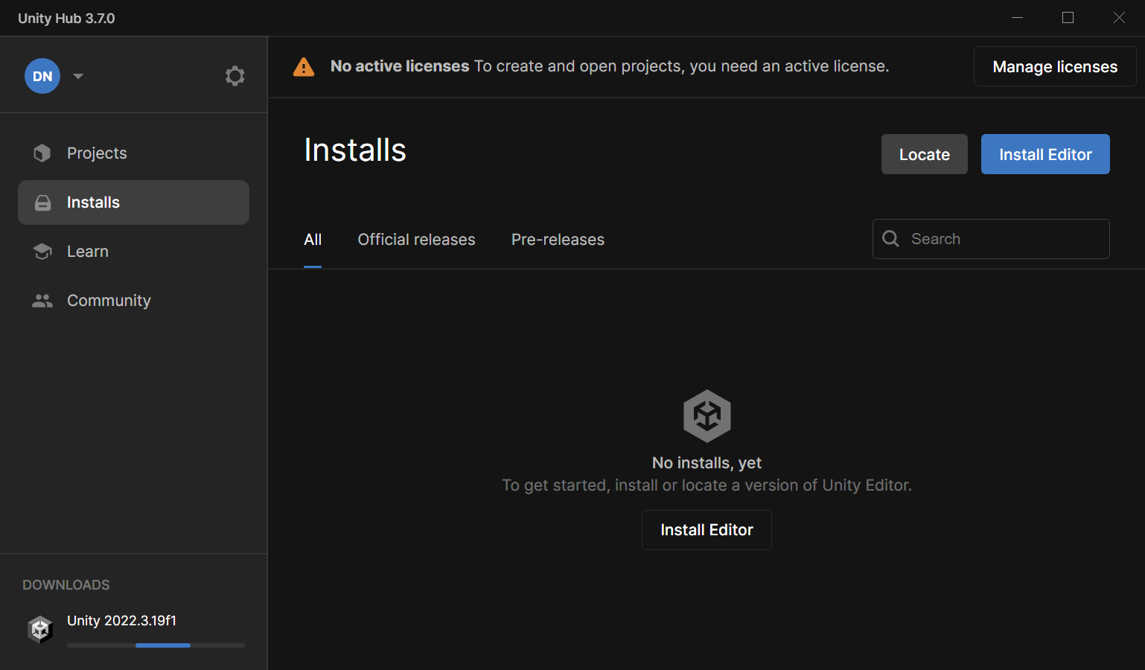
First install the following
Unity Hub : https://unity.com/download
Still need to install an engine! Open the hub, install what it suggests

Slide 34
What is Unity?
Unity is a “game engine”
Framework for interactive application (do you know any other than games?)
Provides API for rendering, physics, networking, AI, collision, etc….

Slide 35
Why Unity? Any ideas?

Slide 36
Why Unity?
Most popular game engine on the market
Easier to google problems (or ChatGPT ☹)
C# is a low barrier to entry (Unreal uses C++)
Useful for other courses

Slide 37
Why not Unity? Any ideas?

Slide 38
Why not Unity?
Closed source
Hides what we’re interested in
Has a lot of things we don’t need
Maybe we would like to do things ourself
Uncertain future

Slide 39
What do we need to learn
Unity Editor
C#
HLSL

Slide 40
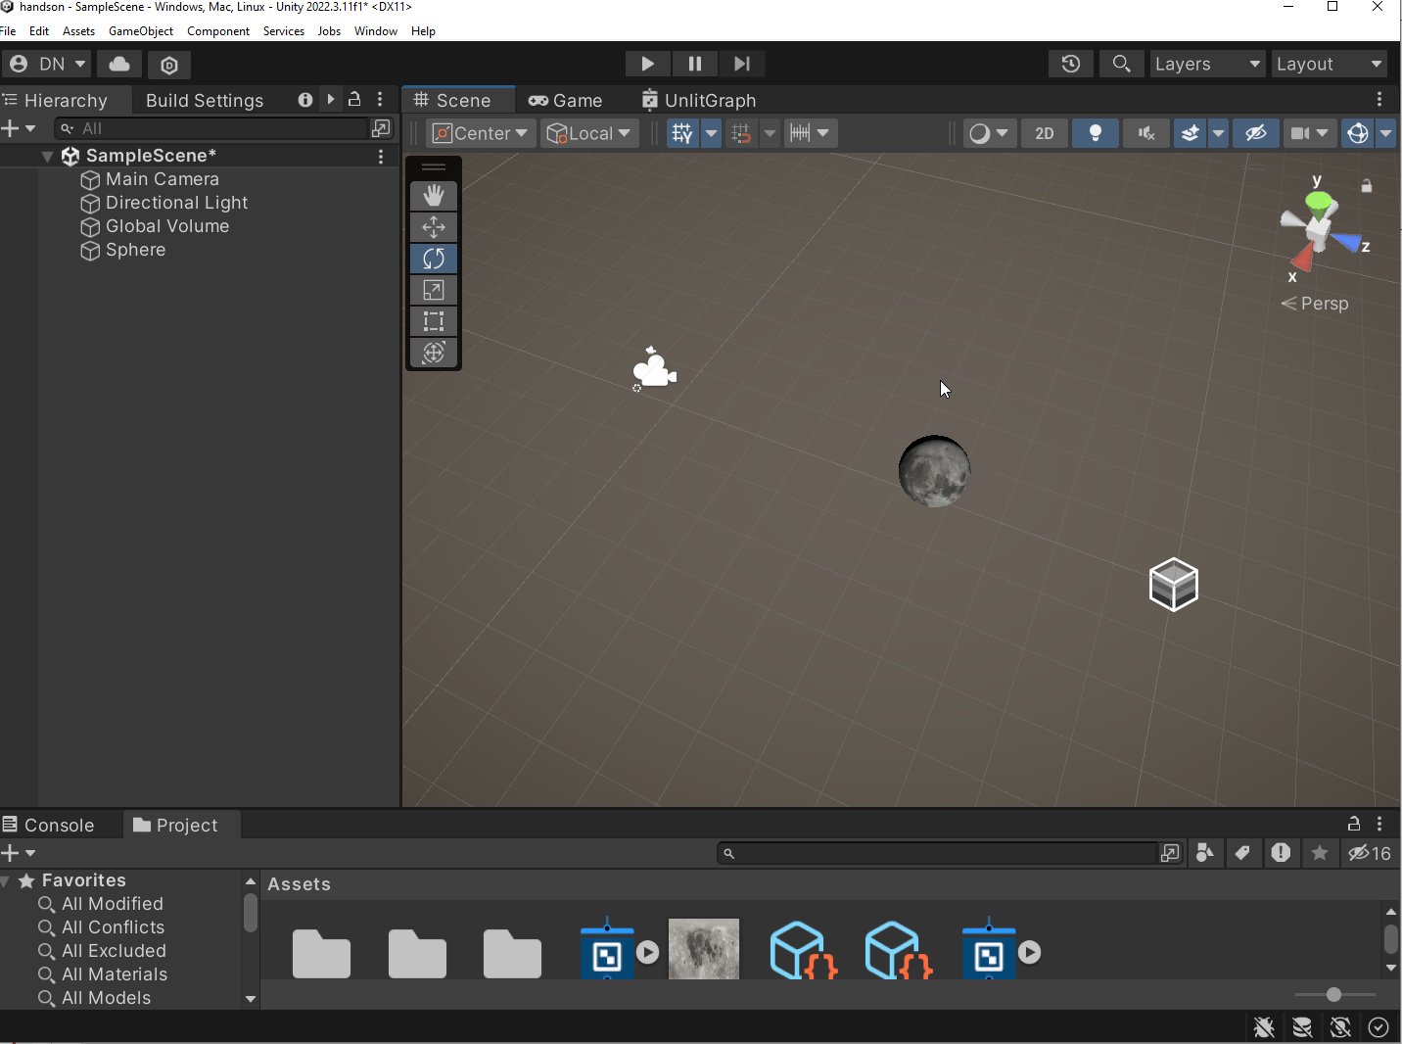
1 Unity Editor
Lot’s of buttons ☹
Artist focused ☹

Slide 41
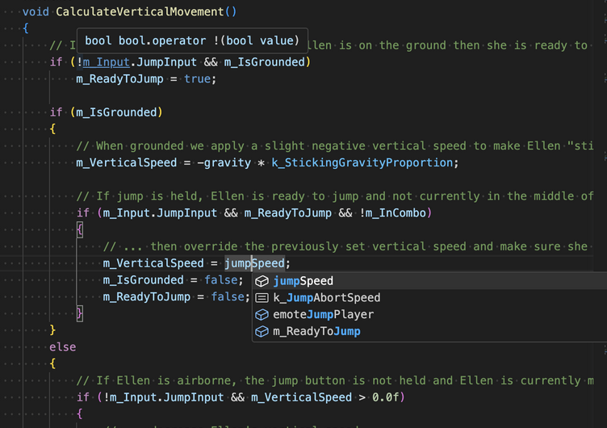
2 C#
Used by Unity for CPU scripting
Very useful language to know
Looks a lot like Java

Slide 42
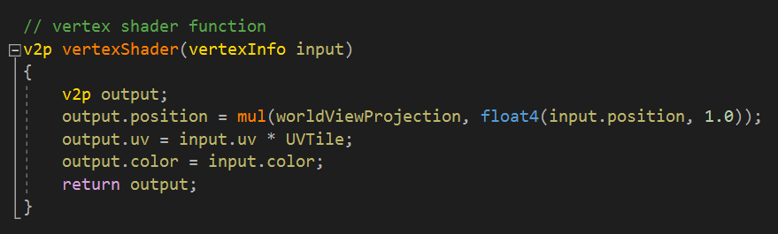
3 HLSL
GPU programming language
No oop ☺
Lots of support for math

Slide 43
The next hour-ish
We’re going to do an experiment
We’re going to implement a “material” (how something looks) in Unity
We want to see if we can render a blue sphere
We’re going to introduce a lot of terms fast
Don’t worry! Will come back in detail in class
This is an exercise to show you (most) of what we’re going to see

Slide 44
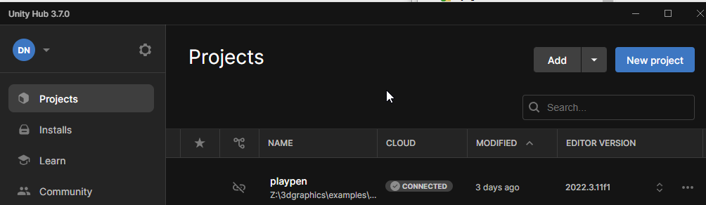
1 : Create a new project

Slide 45
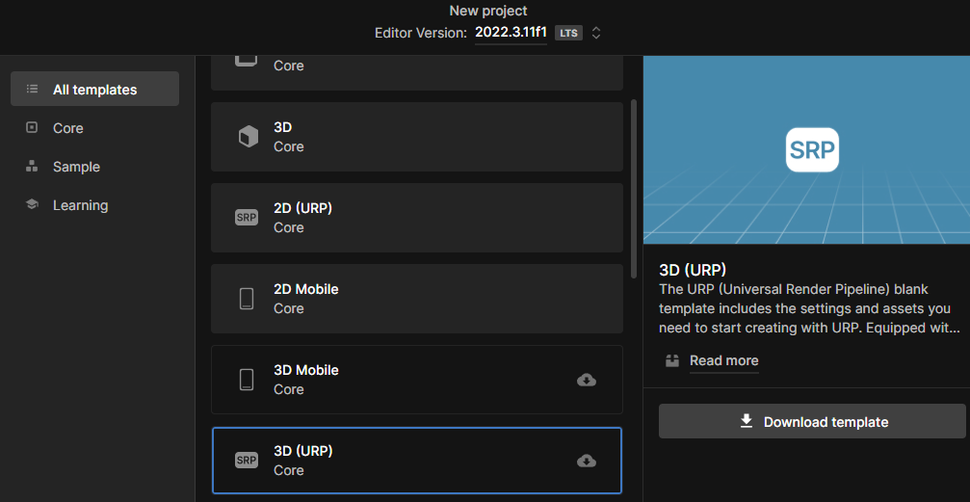
2. Choose 3D (URP), download template

Slide 46
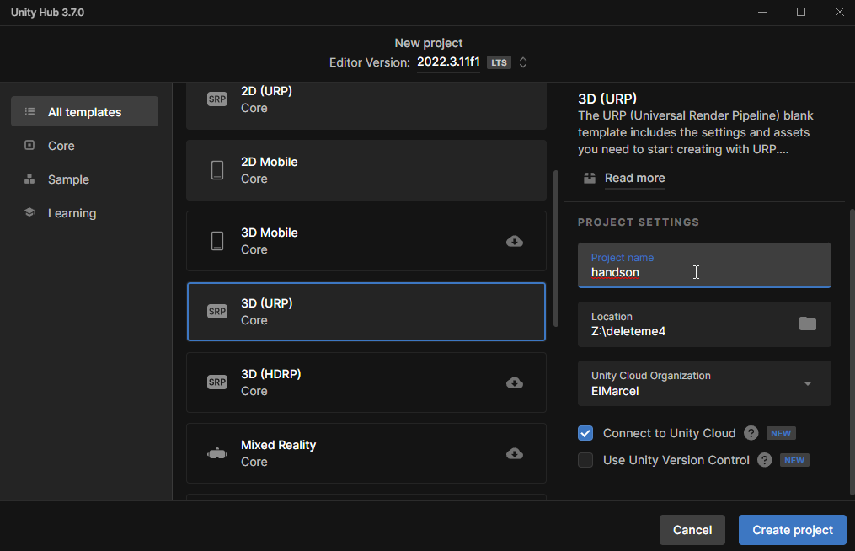
3 Actually create the project
Location doesn’t matter
We won’t use this project after this class
Not a cloud drive (like OneDrive)!

Slide 47
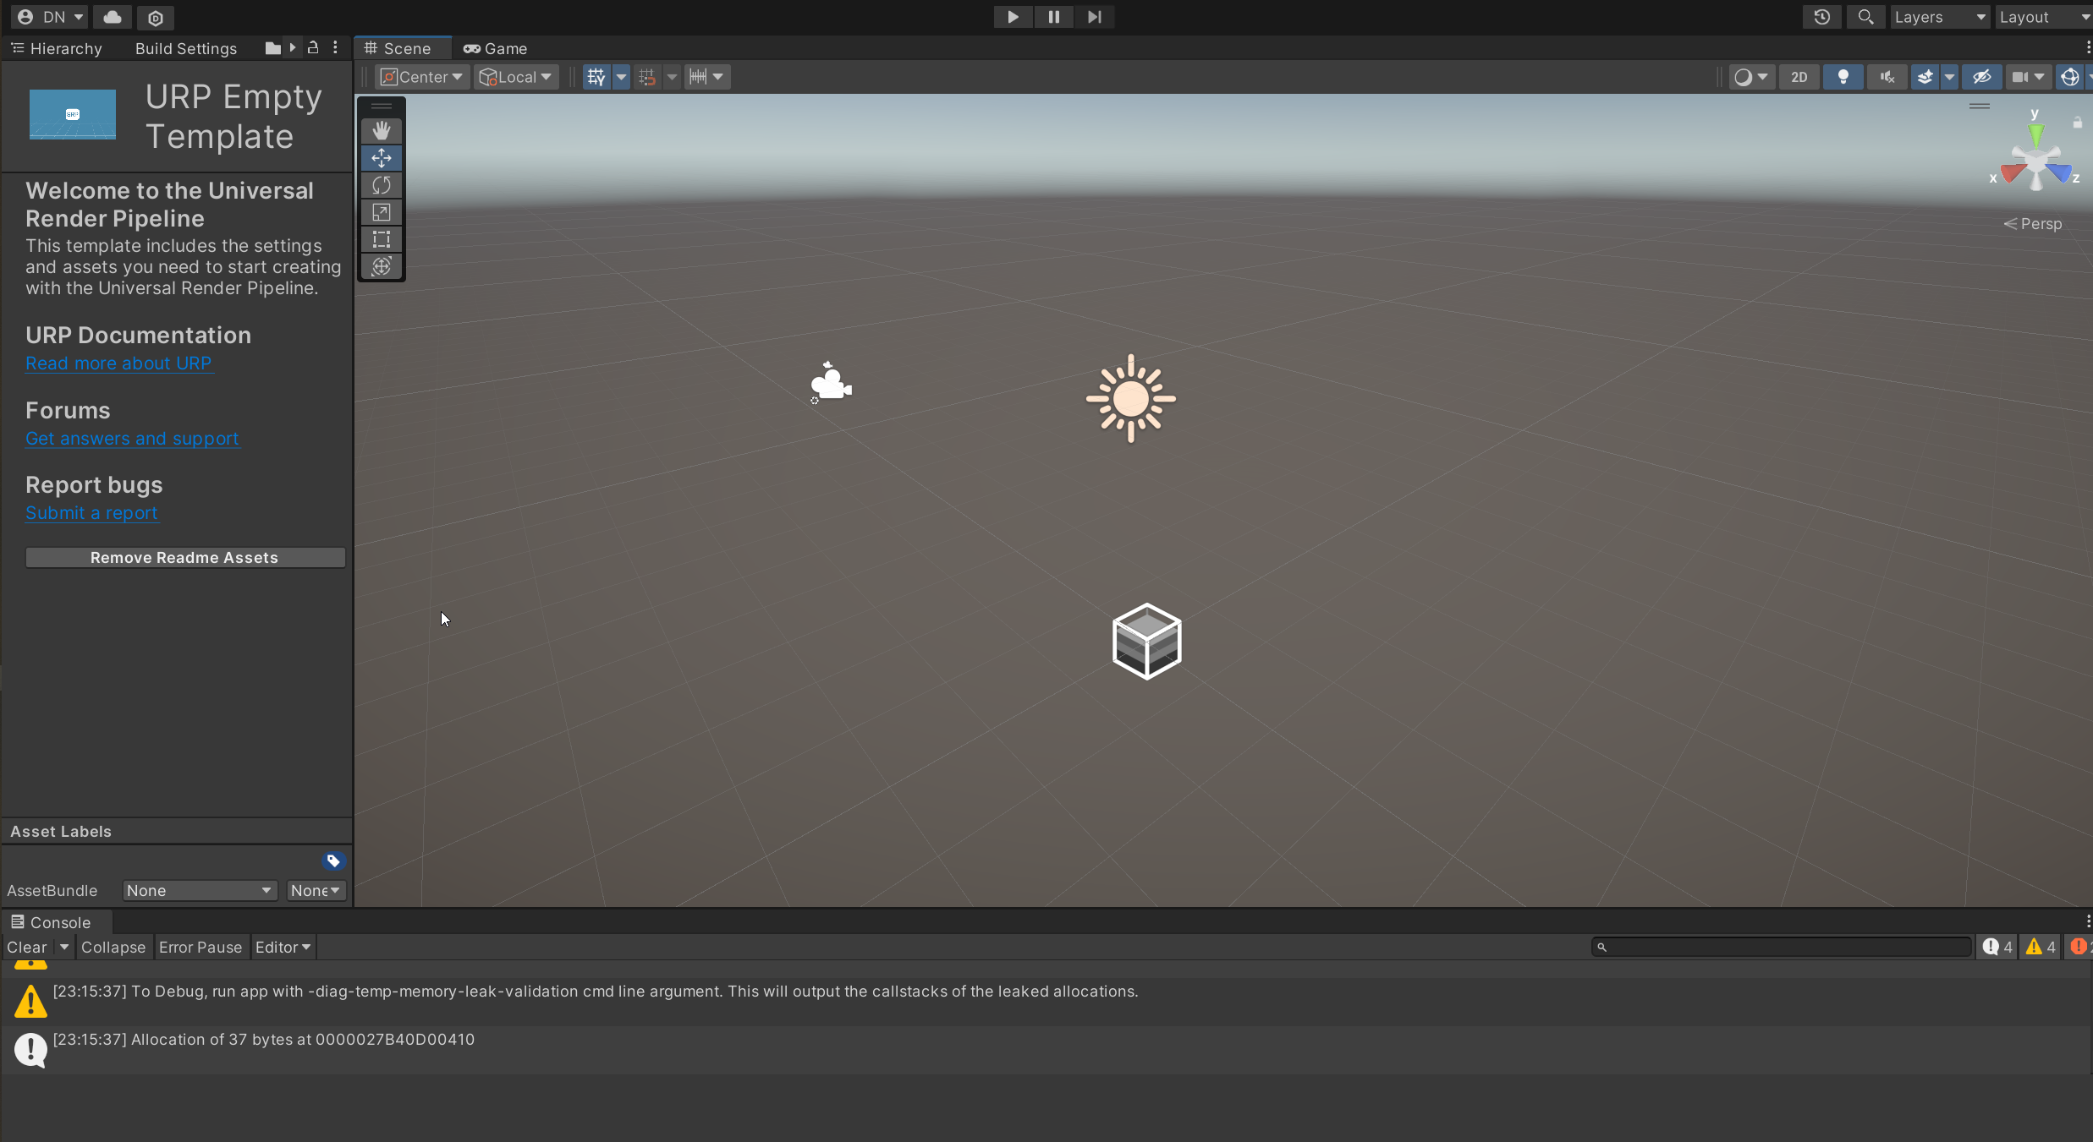
4 Check that you see this, and try to move around
RMB to rotate the camera
MMB to pan the camera
Scrollwheel to zoom

Slide 48
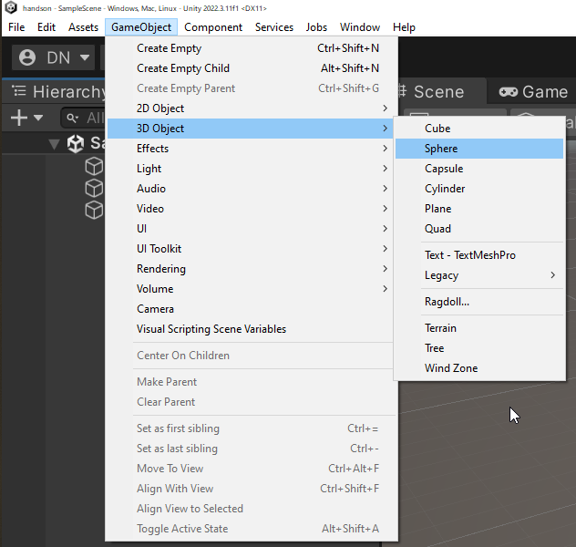
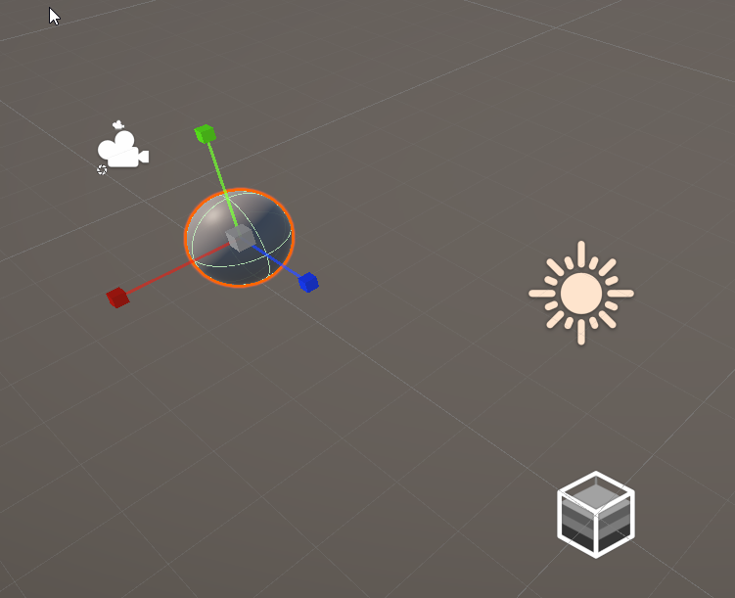
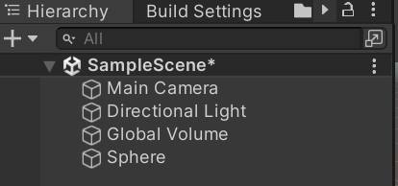
5 Add a sphere to the world

Slide 49
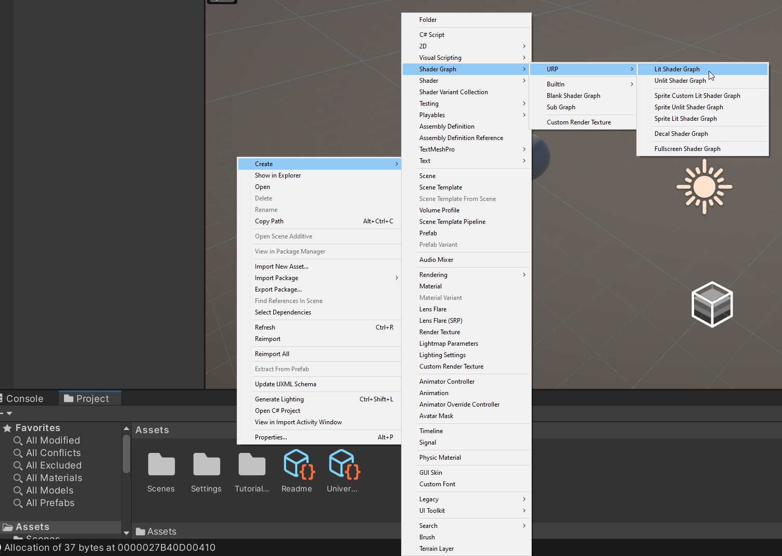
6 Right click in project window, Create->Shader Graph->URP->Lit Shader Graph

Slide 50
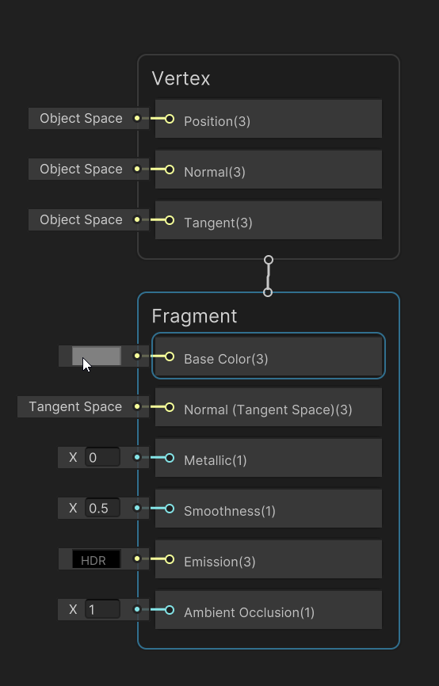
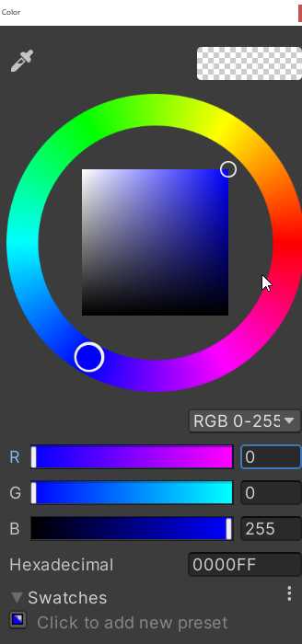
7 Click the box next to “Base Color”, and pick blue

Slide 51
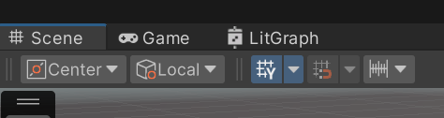
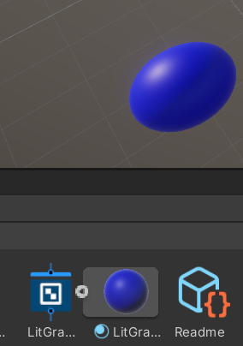

8 Go back to scene view. Click arrow next to graph, and drag that (material) on the scene sphere

Slide 52
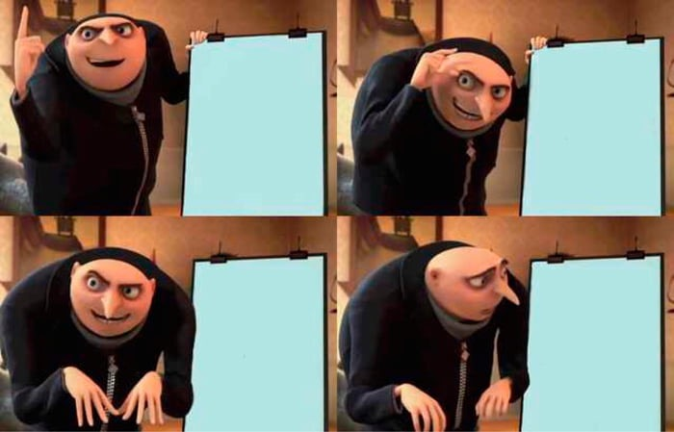

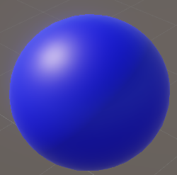
9 Victory?

Slide 53
What is the difference between these two?

Slide 54
This is a sphere that is pure blue

Slide 55
This is a blue sphere, lit by a light

Slide 56
We are going to learn how to make the lit one
By ourself
This is an example of Unity being helpful (we don’t need to know)
But it’s unhelpful (we want to learn how it to do it)

Slide 57
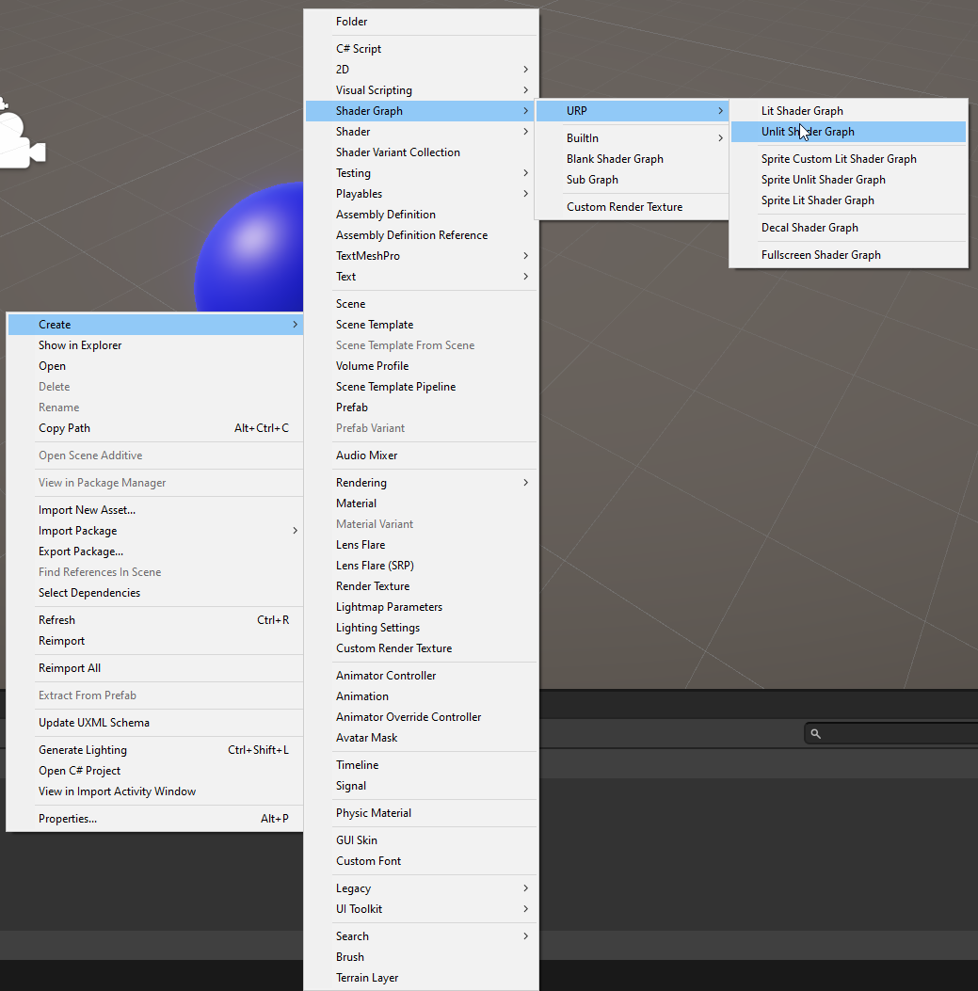
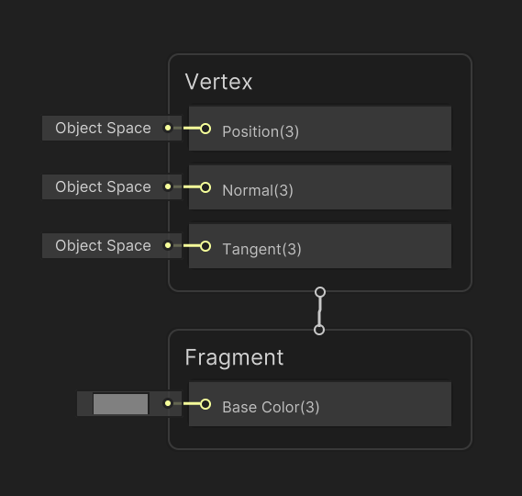
10 Right click in project window, Create->Shader Graph->URP->Unlit Shader Graph

Slide 58
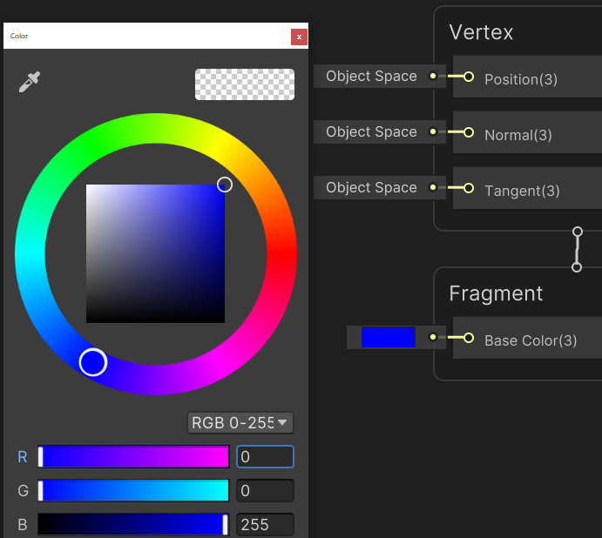
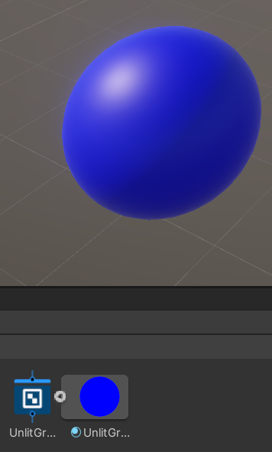
11 Set base color to blue, SAVE, apply the material

Slide 59

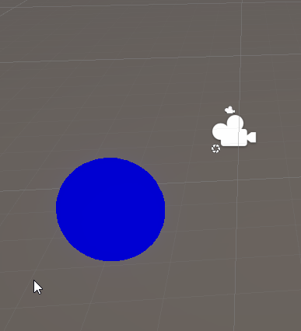
12 Check your results in Scene View

Slide 60
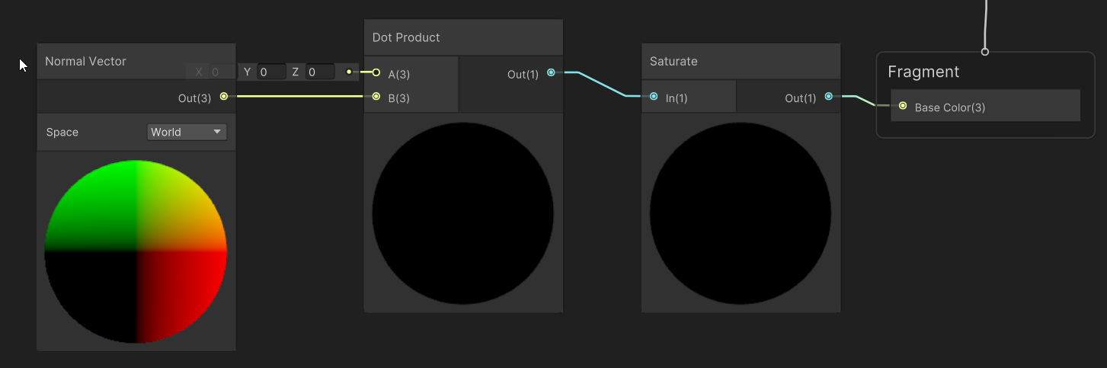
13 Start adding nodes to your graph On graph: right click, create node
Create a Saturate node, connect its output to Base Color’s input
Create a Dot Product node, connect its output to Saturate’s input
Create a Normal Vector node, connect it’s ouptup to Dot Product’s input

Slide 61
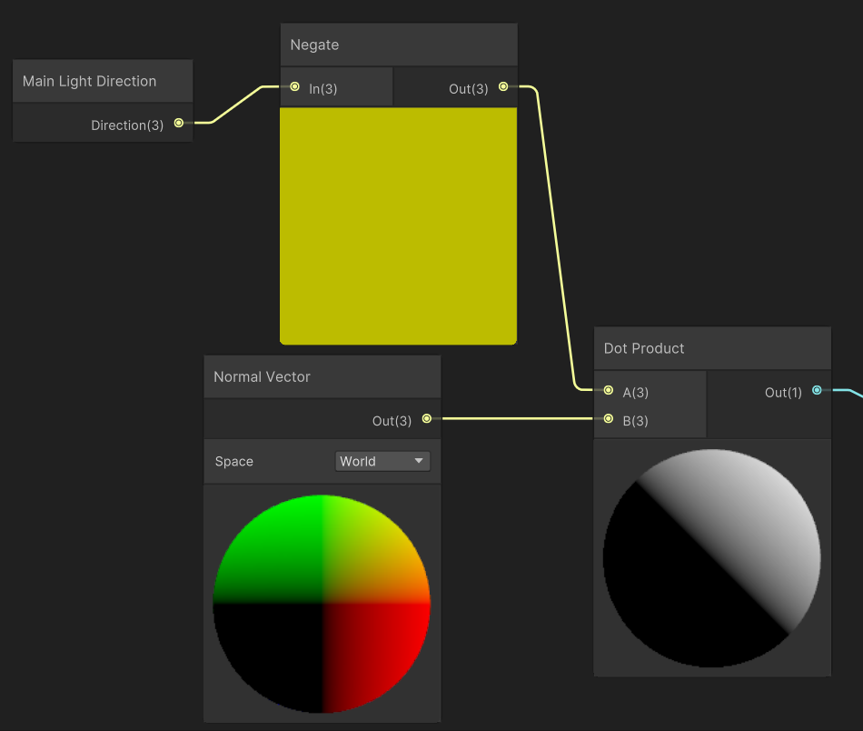
14 Continue adding nodes to your graph
Create a Negate node
Connect it to Dot Product’s free input
Create a Main Light Direction node
Connect it to Negate’s input

Slide 62
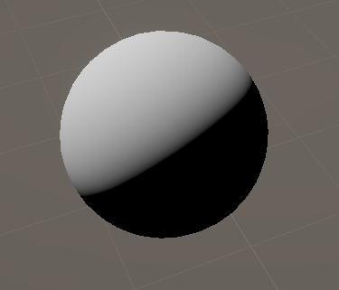
15 Save your graph and check your results

Slide 63
This looks very interesting!
Does this look like something you know?
If you think your answer is ridiculous, it might be correct

Slide 64
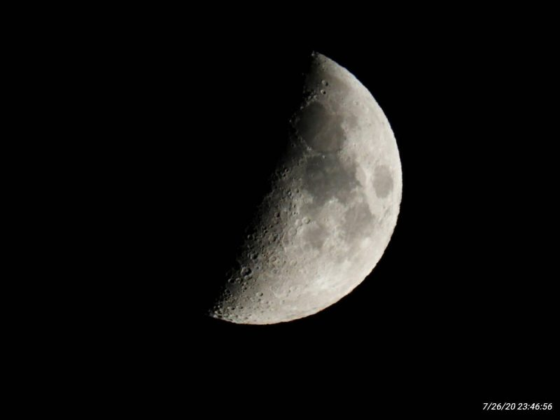
This looks very interesting! (not a joke)

Slide 65
We have just implemented diffuse lighting
Diffuse lighting dominates on rough materials : unglazed pottery, dusty surfaces
It’s color and intensity is independent of the angle you look at it from
You can check by moving your head
Any other examples of diffuse materials?

Slide 66
We used 3 concept to implement it
The normal, N
The light direction, L
The dot product

Slide 67
1 N is the vector perpendicular to the surface
N

Slide 68
1 N is the vector perpendicular to the surface

Slide 69
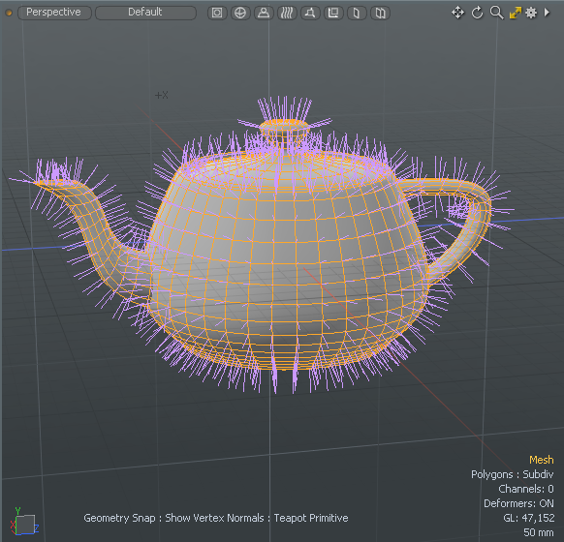
1 N is the vector perpendicular to the surface

Slide 70
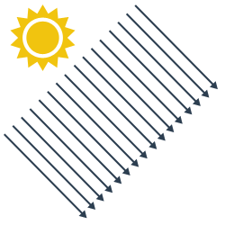
2 The light direction
N

Slide 71

2 The light direction
L
Main Light
Direction
N
N

Slide 72
3 The dot product
Takes two vectors
Outputs how “similar” the vectors are
Goes from -1 to +1
Dot = 1.0
Dot = -1.0
Dot = 0.0
Dot = 0.7

Slide 73
So now we should understand this image
Blue = N
Yellow = L

Slide 74
You see why this course is complex
Many small parts before it comes together
This diffuse implementation is incredibly simple
But now we can build on it
It’s still unclear, because I left quite a lot out

Slide 75
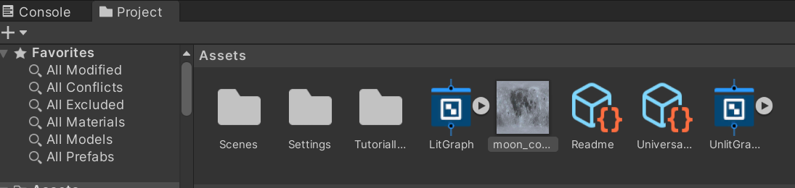
Let’s use a texture for a nicer result
Download textures from Toledo
Drag moon_color.jpg onto your project window

Slide 76
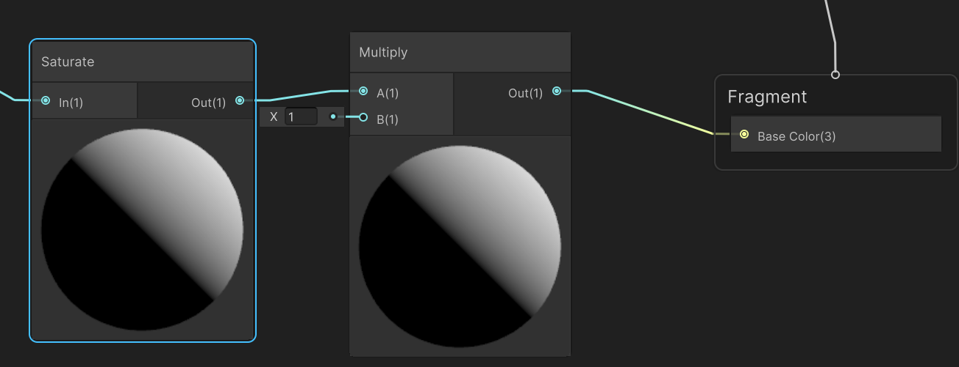
Add a Multiply between Saturate and the output

Slide 77
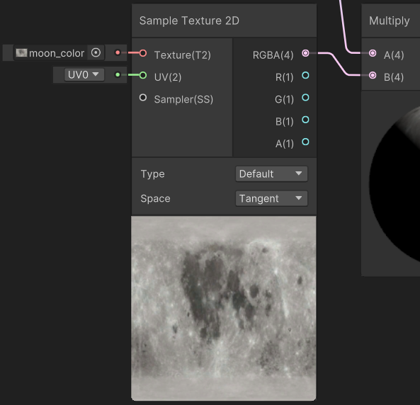
Add a Sample Texture 2D
Connect the output to the free input on Multiply
Set the input texture to our moon_color

Slide 78
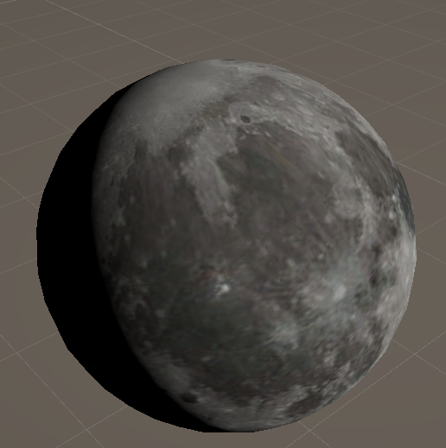
Save and check your results
Does this look good to you?
What is missing?

Slide 79
It looks flat
It looks painted on
Almost like a balloon or marble
This is because we are still lighting it as a sphere
Normal maps can fix this

Slide 80
Quick tour of the rest of the course

Slide 81
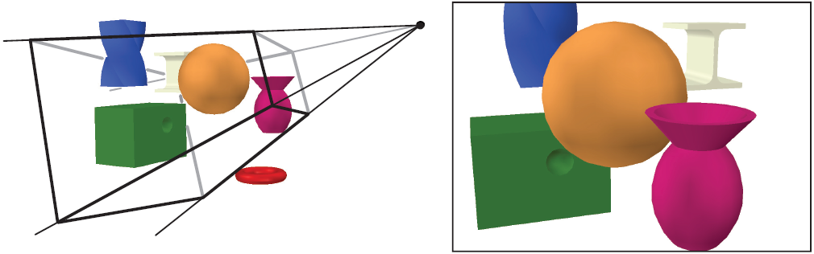
Camera’s

Slide 82
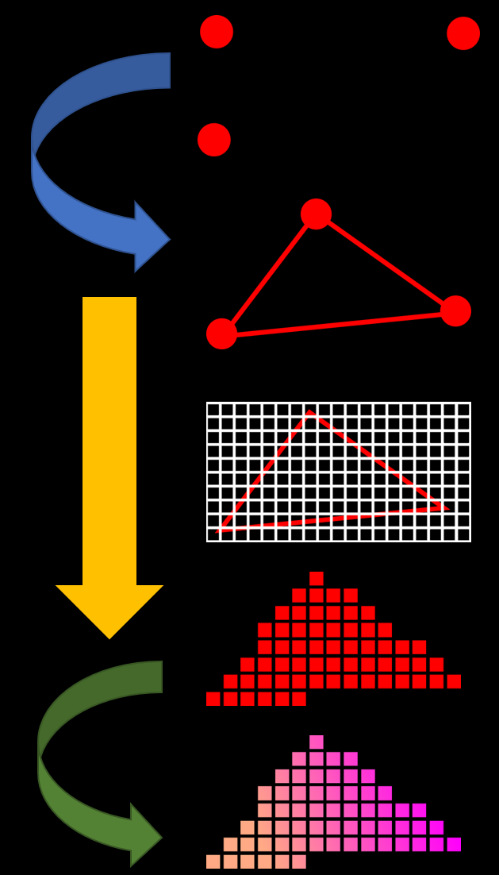
Pipeline

Slide 83
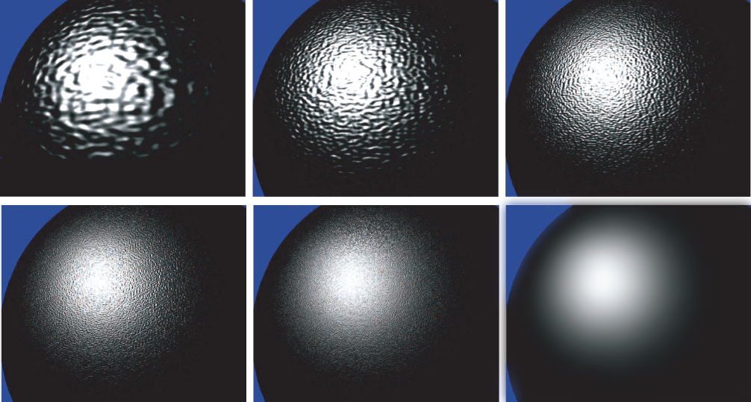
Materials

Slide 84
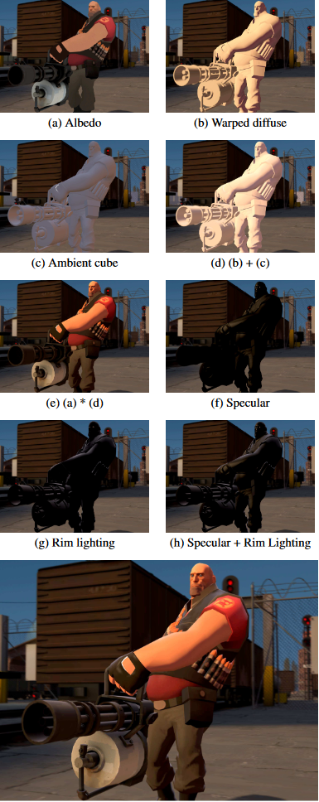
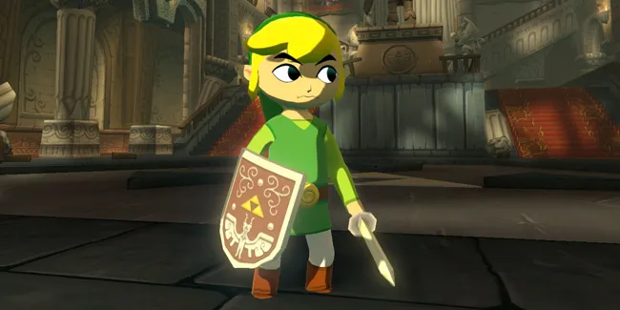
Materials

Slide 85
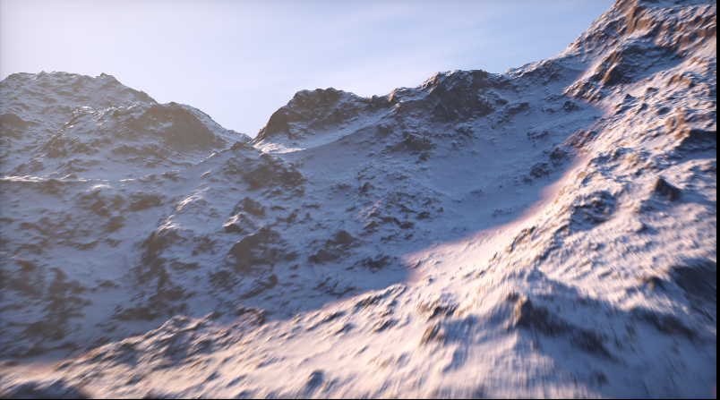
Procedural generation
https://www.shadertoy.com/view/MdX3Rr

Slide 86
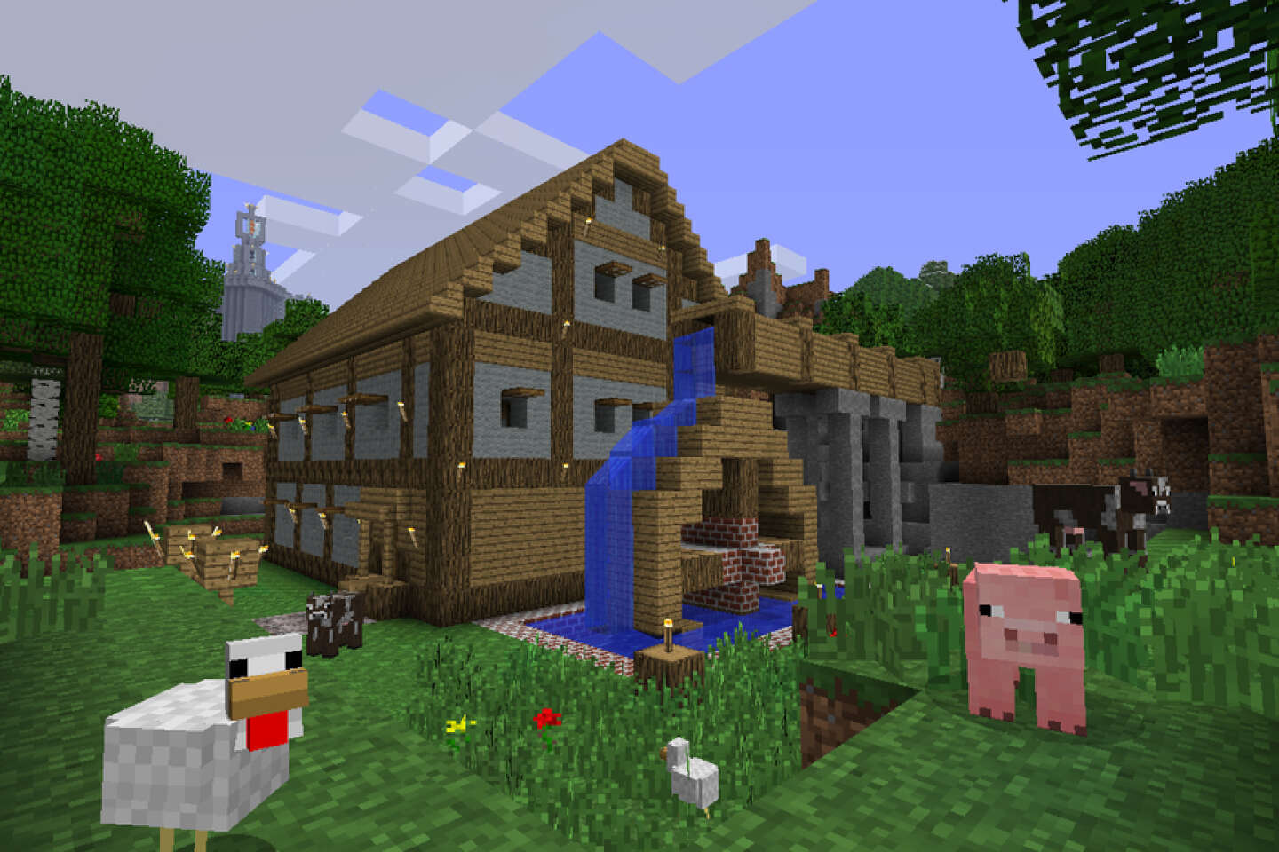
Procedural generation

Slide 87
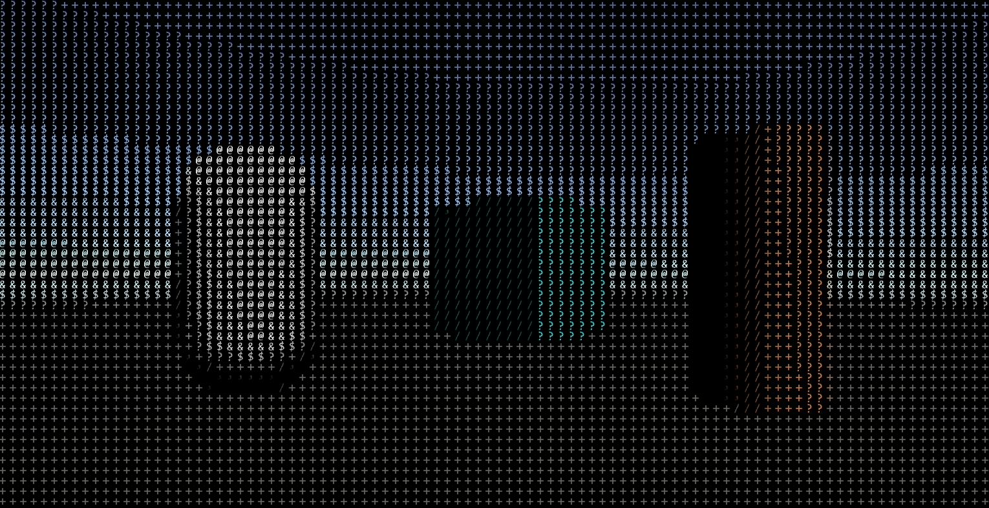
Post Processing

Slide 88
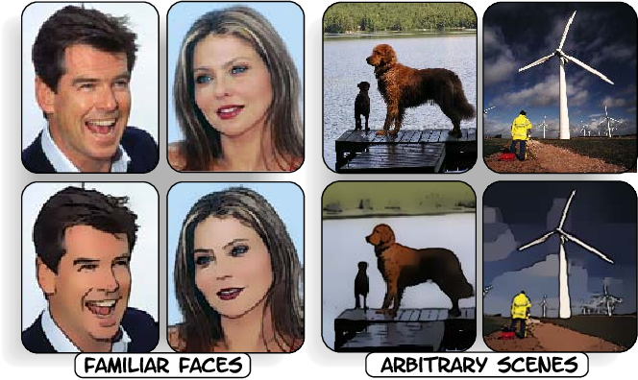
Post Processing

Slide 89
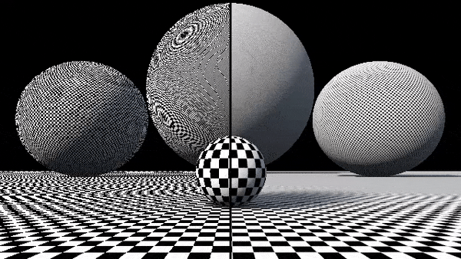
Aliasing

Slide 90
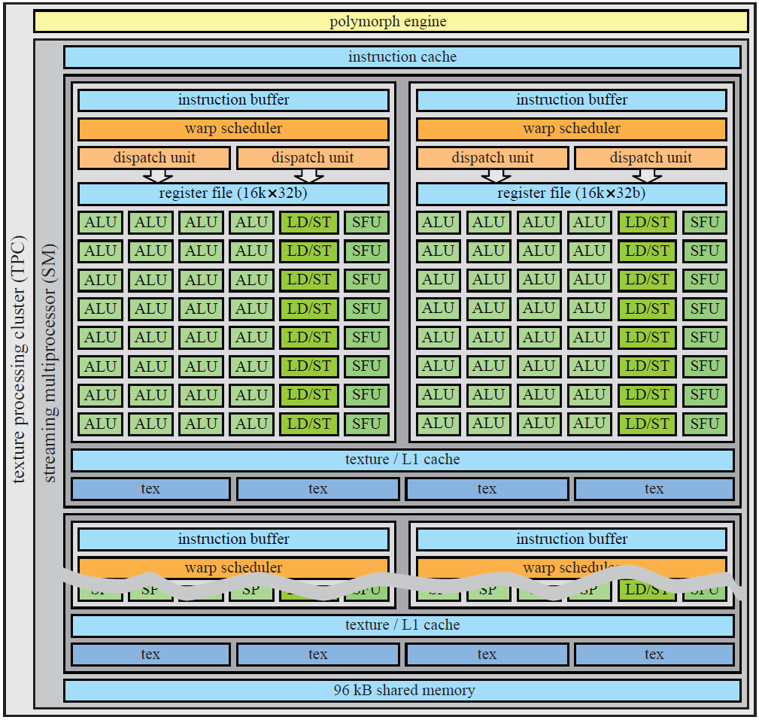
(Hardware)

Slide 91
Recap
This course teaches you how 3d rendering works
Specifically, realtime 3d rendering
It’s a lot of simple concepts
These concepts interact, so it can be rough

Slide 92
Thursday
Lab
Focus on Unity types
Focus on C#
Some 3D coordinates and manipulation

